Slide 2
Objectives
Understand the need to check for errors after data transmission
Describe each of the following error detection methods:
Parity check (odd and even) • Checksum
Echo check
Describe how check digits are used in data entry including:
ISBN • Bar codes
Describe how an automatic repeat query (ARQ) is used to establish data is correctly received

Slide 3
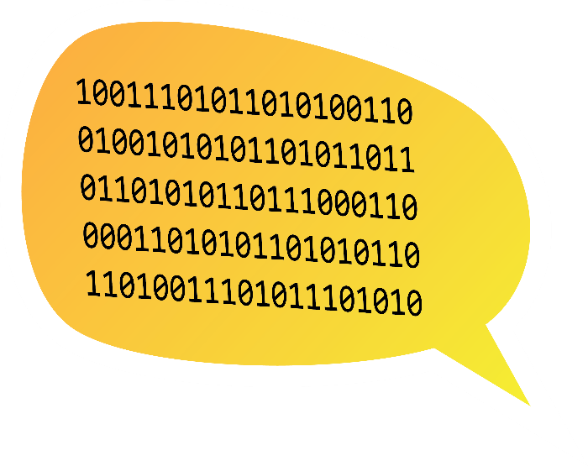
Starter
Work in a pair
One partner reads out the binary numbers in the speech bubble
The other partner must write down the number heard without looking at this slide
How can you do this in the fastest way, whilst making sure that you are 100% accurate?

Slide 4
Starter
Some possible ways that you can make sure the number was entered correctly:
Repeat back numbers
Give the numbers in sets of digits, such as four digits at a time, then repeat back
Have the listener confirm they heard correctly after each block of numbers

Slide 5
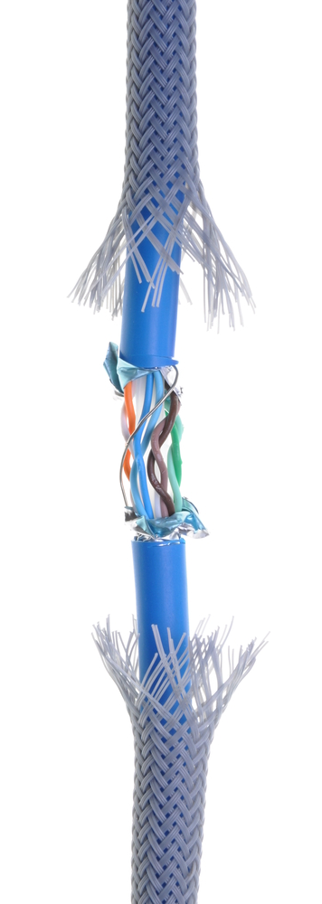

Transmission errors
When data is transmitted, errors may be introduced due to:
Electrical interference
Power surges
Synchronisation issues
Wear and tear on the cable or connectors
These errors may cause:
Data to be lost
Data to be gained
Data to be changed

Slide 6
Error checking
Computers need methods to check for data transmission errors caused by interference
These methods include the use of:
Parity bits
Check digits
Check sums
Echo checks and
Automatic Repeat reQuests (ARQ)

Slide 7
Parity bits
When sending a byte of data, one bit is used as a parity bit
This is used to check if there is an error in the transmission
For an even parity bit, the parity bit is set to 1 or 0 so that the total number of 1s transmitted are an even number
For example, if the binary number 1010001 is to be transmitted, the parity bit is set to 1 so that the number has an even number of 1 bits – four in this case
1 | 0 | 1 | 0 | 0 | 0 | 1 | 1
Parity bit

Slide 8
Odd or even parity
For even parity, all the 1s, including the parity bit, must add up to an even number
For odd parity, all the 1s must add to an odd number
What are the parity bits that would be required for the following numbers?
Even parity
0 | 0 | 1 | 1 | 0 | 0 | 1 | ?
Odd parity
Parity bit
1 | 1 | 1 | 0 | 1 | 0 | 1 | ?
Parity bit

Slide 9
Odd or even parity
What are the parity bits that would be required for the following numbers?
Even parity
0 | 0 | 1 | 1 | 0 | 0 | 1 | 1
Odd parity
Parity bit
1 | 1 | 1 | 0 | 1 | 0 | 1 | 0
Parity bit

Slide 10
Using parity for error detection
When data is transmitted, the parity bit is set at the transmitting end and parity is checked at the receiving end
If the wrong number of bits are found, an error has occurred
It isn’t possible with parity checks to know which bit was incorrectly transmitted
If a transmission error is found, the receiving device notifies the transmitting end and the data is resent
Will a parity check find all errors that are possible when transmitting data?

Slide 11
Parity in error detection
Will a parity check find all errors that are possible when transmitting data?
No - not all possible errors will be detected. For example, if two bits are changed in transmission, these won’t be detected
The received byte has two mistakes, but the parity bit is correct
Transmitted byte
0 | 0 | 1 | 1 | 0 | 0 | 1 | 1
Received byte
Parity bit
1 | 1 | 1 | 1 | 0 | 0 | 1 | 1
✗
✗
Parity bit

Slide 12
Parity block check
In a parity block check, each byte has a parity bit, whilst an additional parity byte is sent at the end of the block
Check the first three bytes to see if there are any problems with the parity bits
 | Parity bit | Bit 1 | Bit 2 | Bit 3 | Bit 4 | Bit 5 | Bit 6 | Bit 7
Byte 1 | 0 | 0 | 1 | 1 | 1 | 0 | 1 | 0
Byte 2 | 0 | 1 | 0 | 1 | 1 | 0 | 0 | 1
Byte 3 | 1 | 1 | 1 | 0 | 0 | 1 | 1 | 0
Byte 4 | 1 | 0 | 0 | 1 | 1 | 0 | 0 | 1
Byte 5 | 0 | 1 | 1 | 1 | 1 | 1 | 1 | 0
Byte 6 | 1 | 0 | 1 | 0 | 1 | 0 | 1 | 0
Byte 7 | 0 | 1 | 0 | 1 | 0 | 1 | 0 | 1
Byte 8 | 0 | 1 | 1 | 1 | 0 | 0 | 0 | 1
Parity Byte | 1 | 1 | 1 | 0 | 1 | 0 | 0 | 0
Even parity has been used

Slide 13
Parity block check
Check the first three bytes to see if there are any problems with the parity bits
We know that Byte 3 has an error in it
Now check the Parity Byte for each bit to see which bit contains the error
 | Parity bit | Bit 1 | Bit 2 | Bit 3 | Bit 4 | Bit 5 | Bit 6 | Bit 7
Byte 1 | 0 | 0 | 1 | 1 | 1 | 0 | 1 | 0
Byte 2 | 0 | 1 | 0 | 1 | 1 | 0 | 0 | 1
Byte 3 | 1 | 1 | 1 | 0 | 0 | 1 | 1 | 0
Byte 4 | 1 | 0 | 0 | 1 | 1 | 0 | 0 | 1
Byte 5 | 0 | 1 | 1 | 1 | 1 | 1 | 1 | 0
Byte 6 | 1 | 0 | 1 | 0 | 1 | 0 | 1 | 0
Byte 7 | 0 | 1 | 0 | 1 | 0 | 1 | 0 | 1
Byte 8 | 0 | 1 | 1 | 1 | 0 | 0 | 0 | 1
Parity Byte | 1 | 1 | 1 | 0 | 1 | 0 | 0 | 0
Even parity has been used

Slide 14
Parity block check
Check the first three bytes to see if there are any problems with the parity bits
We know that Byte 3 has an error in it
Now check the Parity Byte for each bit to see which bit contains the error
 | Parity bit | Bit 1 | Bit 2 | Bit 3 | Bit 4 | Bit 5 | Bit 6 | Bit 7
Byte 1 | 0 | 0 | 1 | 1 | 1 | 0 | 1 | 0
Byte 2 | 0 | 1 | 0 | 1 | 1 | 0 | 0 | 1
Byte 3 | 1 | 1 | 1 | 0 | 0 | 1 | 1 | 0
Byte 4 | 1 | 0 | 0 | 1 | 1 | 0 | 0 | 1
Byte 5 | 0 | 1 | 1 | 1 | 1 | 1 | 1 | 0
Byte 6 | 1 | 0 | 1 | 0 | 1 | 0 | 1 | 0
Byte 7 | 0 | 1 | 0 | 1 | 0 | 1 | 0 | 1
Byte 8 | 0 | 1 | 1 | 1 | 0 | 0 | 0 | 1
Parity Byte | 1 | 1 | 1 | 0 | 1 | 0 | 0 | 0
Even parity has been used

Slide 15
Parity block check
We now know which row and column the error is in, so we can identify it
The bit can now be corrected
 | Parity bit | Bit 1 | Bit 2 | Bit 3 | Bit 4 | Bit 5 | Bit 6 | Bit 7
Byte 1 | 0 | 0 | 1 | 1 | 1 | 0 | 1 | 0
Byte 2 | 0 | 1 | 0 | 1 | 1 | 0 | 0 | 1
Byte 3 | 1 | 1 | 1 | 0 | 0 | 1 | 1 | 0
Byte 4 | 1 | 0 | 0 | 1 | 1 | 0 | 0 | 1
Byte 5 | 0 | 1 | 1 | 1 | 1 | 1 | 1 | 0
Byte 6 | 1 | 0 | 1 | 0 | 1 | 0 | 1 | 0
Byte 7 | 0 | 1 | 0 | 1 | 0 | 1 | 0 | 1
Byte 8 | 0 | 1 | 1 | 1 | 0 | 0 | 0 | 1
Parity Byte | 1 | 1 | 1 | 0 | 1 | 0 | 0 | 0
Even parity has been used

Slide 16
Worksheet 3
Complete Task 1 on Worksheet 3

Slide 17
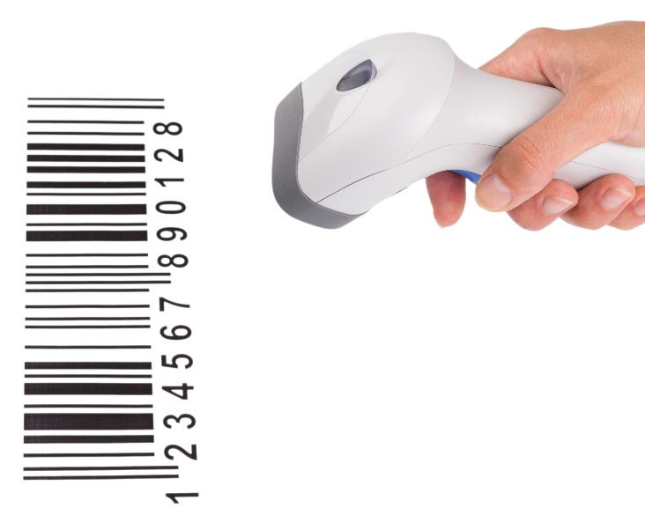
Checking data entry
Barcodes and other numbers have check digits which are used to make sure a number has been entered correctly
A barcode scanner may misread the number and request it to be scanned again
A checkout assistant or customer may mistype the number if they have to enter it manually

Slide 18
Check digits
A check digit is an additional digit at the end of a set of other numbers designed to check for mistakes in input or transmission
Printed books have a unique barcode with an ISBN (International Standard Book Number)
Other products contain bar codes using formats such as UPC (Universal Product Code)
Both codes make use of check digits to make sure they have been scanned or entered correctly

Slide 19
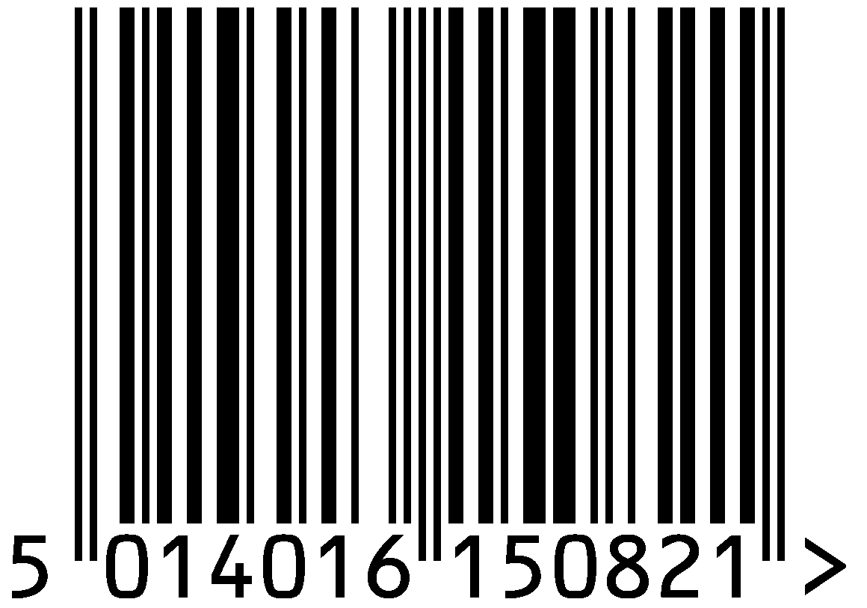
Calculating the check digit
Check digits are calculated by multiplying each number by a weight of 1 or 3 as shown below
The rest of the algorithm is then completed
ISBN | 5 | 0 | 1 | 4 | 0 | 1 | 6 | 1 | 5 | 0 | 8 | 2 | 1
Weight | 1 | 3 | 1 | 3 | 1 | 3 | 1 | 3 | 1 | 3 | 1 | 3
Multiplication | 5 | 0 | 1 | 12 | 0 | 3 | 6 | 3 | 5 | 0 | 8 | 6
Addition | Add all the numbers |  |  |  |  |  |  |  |  |  |  |  | 49
Remainder | Find the remainder when divided by 10 |  |  |  |  |  |  |  |  |  |  |  | 9
Subtraction | Subtract the result from 10 |  |  |  |  |  |  |  |  |  |  |  | 1

Slide 20
Worksheet 3
Complete Task 2 and Task 3 on Worksheet 3

Slide 21
Checksums
When transmitting data, in particular files, it is important to be able to check that the file received has no errors introduced when it was transmitted
The file is run through an algorithm that produces a checksum which it also sends
When the file arrives, the receiving computer generates the checksum and compares it with the checksum that was sent
If the checksums don’t match, the file may have been corrupted or altered in transmission

Slide 22

Checksums
Data or a file goes through a checksum algorithm
A checksum is created and sent with the file
When received the checksum is again generated
If it doesn’t match the sent checksum an error has occurred
Transmit
Checksum algorithm
AF83572E
AF83572E
≠
748AFD92
Checksum algorithm
AF83572EF9DA

Slide 23
Echo check
An echo check acts in the same way as an echo from a wall
The data is transmitted to the receiver
The same data is then echoed back to the transmitter
The transmitter compares the data with the original. If it isn’t the same, the data is transmitted again
1. Data sent
Source
Destination
2. All data echoed back
3. Original data and echo compared

Slide 24
Automatic Repeat reQuests
Automatic repeat requests (ARQs) work as follows:
The sender first sends a block of data
The receiving computer then sends back an acknowledgement
When the sender receives the acknowledgement it sends the next block of data
If the acknowledgement is not received after a period of time, a timeout occurs and the data is resent
This process continues until the acknowledgement is received
Sender
Receiver
DATA BLOCK 1
Acknowledgement
DATA BLOCK 2
Timeout
DATA BLOCK 2
Acknowledgement
DATA BLOCK 3
Acknowledgement

Slide 25
ARQ flowchart
START
Set timer
Resend data
Has timer timed out?
Yes
No
No
Acknowledgement received?
Yes
Transmission complete
END

Slide 26
Negative acknowledgements
Sender
Receiver
When a data block is correctly received an acknowledgement (ACK) is sent
When the receiver detects an error in a data block that has been sent, a negative acknowledgement (NACK) is sent
By sending a NACK, the sender doesn’t need to wait so long in a timeout – it can immediately send the data block again
DATA BLOCK 1
ACK
DATA BLOCK 2
NACK
DATA BLOCK 2
Acknowledgement
DATA BLOCK 3
Acknowledgement

Slide 27
Worksheet 3
Complete Task 4 on Worksheet 3

Slide 28


Plenary
Work in a pair
When giving a telephone number or post code over the phone what methods could be used to make sure the numbers given are correct?
What similarities do these have to the methods of error detection covered in this topic?

Slide 29
Plenary
Method 1
When people give numbers on the phone, they will often give them in groups of three or four then wait for them to be repeated back – this is essentially an echo check
Method 2
After each group of numbers or letters are given, the person listening will say ‘yes’ to confirm that they heard the letters correctly – this is similar to an automatic repeat request

